Slide 1
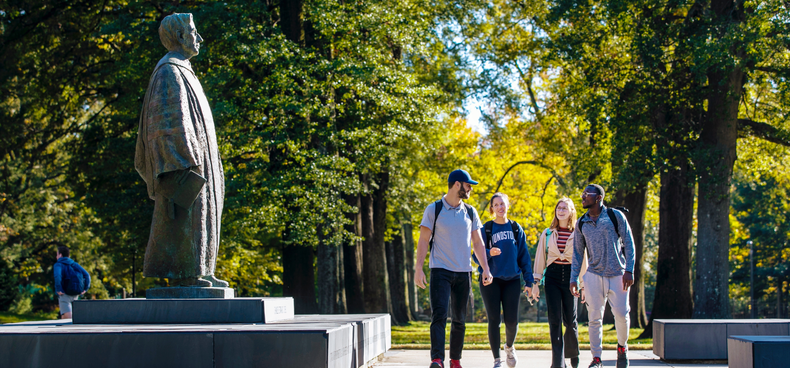
A Place Like No Other

Slide 2
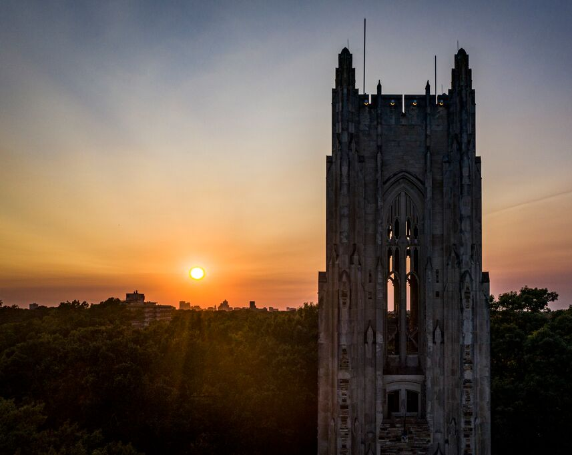
A Place Like No Other
Rhodes College is a national,
four-year, private, coeducational, residential college committed to the liberal arts and sciences.
Our beautiful campus is located in the heart of Midtown Memphis, making Rhodes one of only a few liberal arts colleges located in a major metropolitan area.

Slide 3
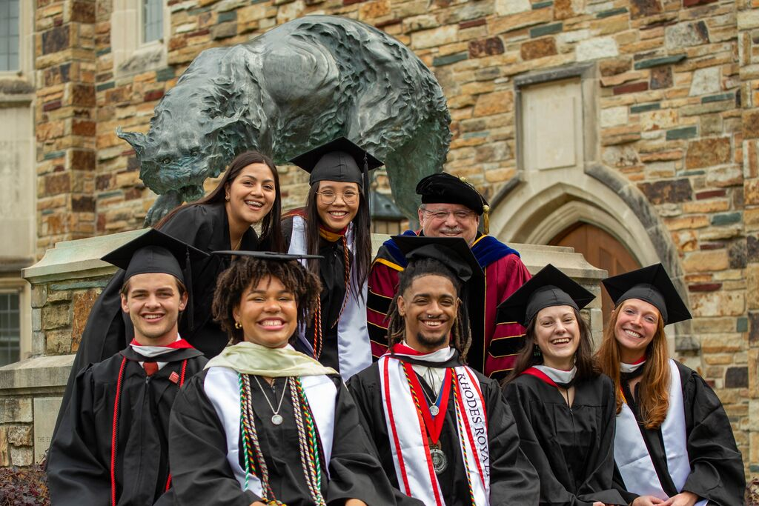
Rhodes College By the Numbers
Approximately 2,070 students representing 45 states (plus D.C.) and 63 countries
More than 50 majors and minors, 12+ academic fields with pre-professional advising
215 faculty, 94% hold highest degree possible in their field
75% of students study abroad or at off-campus sites in the U.S.
100+ student clubs, organizations, intramural and club sports
21 men’s and women’s NCAA Division III intercollegiate teams

Slide 4
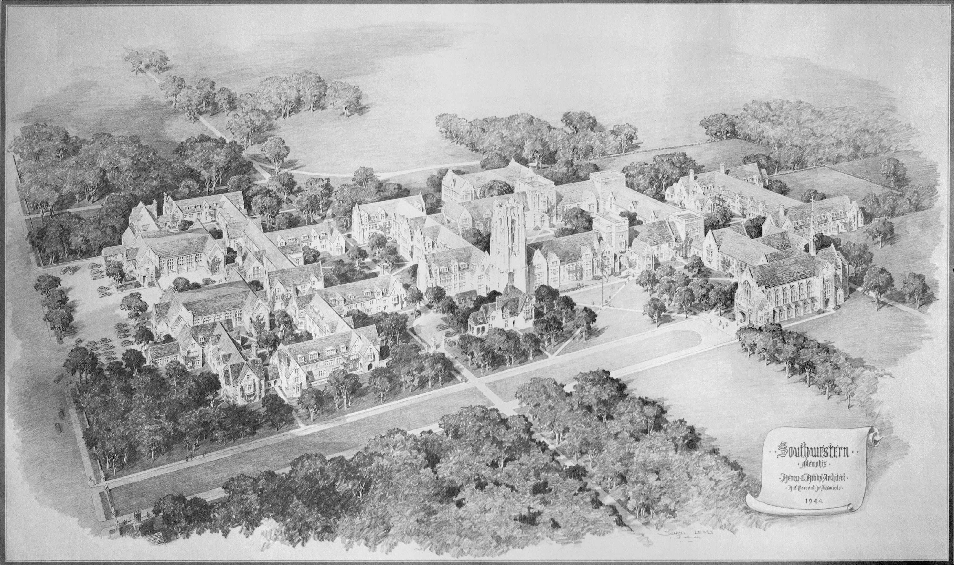
A Place with Deep History
1848: Rhodes College was founded in Clarksville, Tennessee.
1875: The college added an undergraduate School of Theology and became Southwestern Presbyterian University.
1925: President Charles Diehl moved the college campus to Memphis, Tennessee, and the college’s name was changed to Southwestern.
1945: The college adopted the name Southwestern at Memphis.
1984: The college′s name was changed to Rhodes College to honor former college president, and Diehl′s successor, Peyton Nalle Rhodes.
2023: Rhodes College celebrates 175 years since its founding.
2025: Rhodes College will celebrate 100 years in Memphis.
Master Plan of the Southwestern at Memphis Campus, 1944

Slide 5
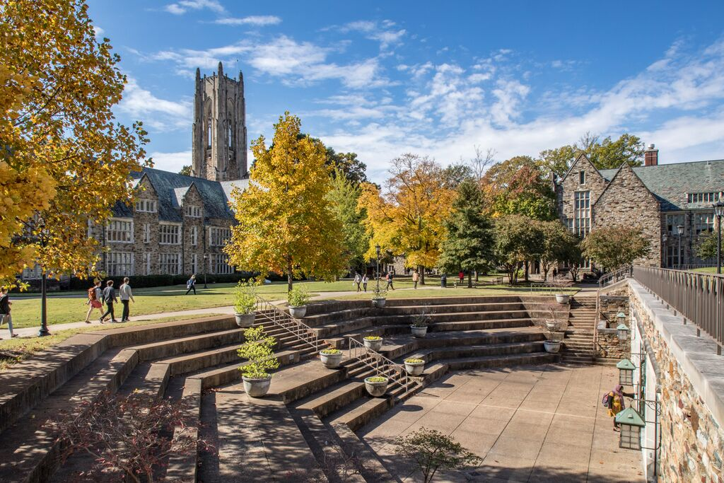
A Place of Unparalleled Beauty
Rhodes College’s campus sits on a 123-acre wooded site in the heart of historic Midtown Memphis.
This beautiful, supportive environment is intentionally designed to encourage intimate conversation, the exchange of ideas, and life-changing connections.
Rhodes’ campus has been named one of the prettiest in the nation by Architectural Digest and has been consistently ranked among the Most Beautiful Campuses in the Nation by The Princeton Review.

Slide 6
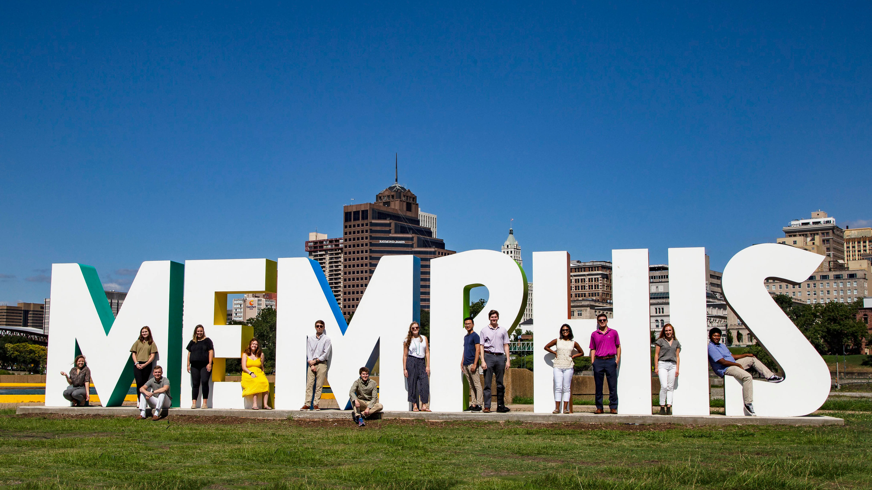
A Place to Find Community
Our campus community is diverse and welcoming.
We have more than 100 student organizations to help students find their place at Rhodes.
Many academic and community-based programs embed students in Memphis, further encouraging them to make our hometown their home.

Slide 7
A Place to Make a Difference
More than 80% of Rhodes students actively participate in community service.
Memphis is a hub for community change. Rhodes enjoys relationships with more than 100 community partners, giving students the option to serve in their areas of interest and passions or to engage with organizations that align closely with their academic majors.
Students also serve internationally through fellowships and study abroad programs.

Slide 8
A Place for Discovery
Through our world-class academics, an engaged, supportive community, and numerous opportunities to explore Memphis and the world, Rhodes empowers students to create their own pathways to self-discovery.

Slide 9
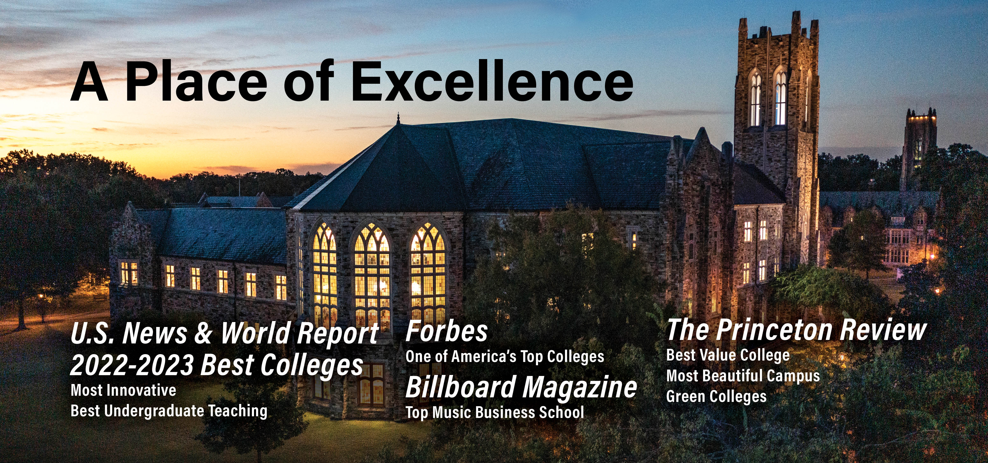
A Place Like No Other

